Slide 1
Physics 123

Slide 2
Lecture 1

Slide 3
Introduction to the Course and

Slide 4
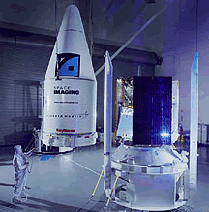


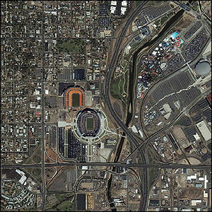

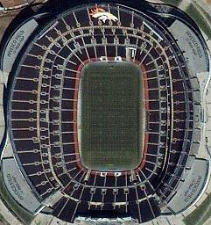
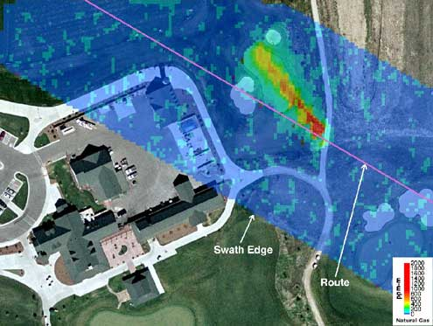
Instructor Introduction
R. Todd Lines
Education
BS Physics – BYU
MS, PhD Physics – NMSU
Recent Experience
12 years at BYUI
6 years with ITT (Eastman Kodak)
Laser radar
Atmospheric physics
Remote sensing
4 years experience with Raytheon
Weather satellite design
6 years experience with the US Army Research Laboratory
Atmospheric physics
Remote sensing

Slide 5
Survey Results

Slide 6

READ YOUR EMAIL!

Slide 7
Old People can do it!

Slide 8
So can you!

Slide 9
Survey Results:
What do you hope to learn from this course?
Most people said they want to learn the principles of physics. We will also learn some problem solving skills that will be useful in Physics and Engineering
What do you hope to do with this new knowledge?
Most said they wanted to apply what they learn in their field

Slide 10
Survey Results
What do you expect the lectures to do for you?
Most wanted the lectures to answer questions and clarify concepts
This is in keeping with the Learning Model
Some wanted all the material to be taught in the lectures.
Some wanted detailed examples of how to solve problems.
I will do the best I can. I will try to emphasize concepts in lectures (but there will be examples) and emphasize computation on the “Exam Prep” days.

Slide 11
Survey Results
What do you expect the book to do for you?
Answers varied
Most said it would be a resource
Some said it is where they do their primary learning
Most said the book would be a resource for learning the material
Studies in 1990’s showed that in introductory physics courses…”
30% of students read the book
30% of students pass the course
The studies showed that the book is most helpful if read in advance of lecture and homework
Think of an English class, could you discuss and understand Hamlet without reading it?
We picked the best, most easy to read book we could find! (but it weights to much)

Slide 12
Survey Results
How many hours a week do you think it will take to learn all you need to know from this course?
Answers varied from 8 to 17.
Most answered around 15
I hope that it will be no more than 15
We meet 5 days a week and you expect two hours out of class for every hour in class = 15 hours
It takes time and effort to grow new neurological connections that support these new skills

Slide 13
Course Description
This course is the second semester of the Principles of Physics sequence.
The course is designed for students majoring in physics, engineering, chemistry, and mathematics.
The course covers topics in waves, thermodynamics, and optics. These areas of study are important in almost all areas of engineering and in all scientific disciplines.
For example, understanding wave properties is essential in construction (civil, mechanical engineering) to avoid unwanted and destructive resonances, wireless communication (electrical engineering), remote sensing (engineering, physics) and many other fields.
Thermodynamics has application in engine design, heat transfer, earth energy balance, and many other important and exciting areas of current research.
Finally, the principles of optics are involved in fiber-optic communications, fiber laser design, instrument design, remote sensing and surveillance system design, etc.

Slide 14
Course Objectives
The primary objective of this course is to help you develop a conceptual understanding of the fundamental physical principles described above.
The second objective of this course is for you to develop the mathematical description of these principles that can then be used to develop devices, structures, and technologies that are useful for mankind.
The third objective of the course is to help you use the mathematical description of these principles to develop problem solving skills that will benefit your future career.

Slide 15
General Philosophy of the Course
Physics is a topic that must be learned by faith, that is, by action.
You will need to read the text and perform the homework assignments in order to succeed in this course.
Studies have indicated there is value of reading the text but principally if the text is read before the lecture
Makes the semester less frustrating, more enjoyable

Slide 16
Building Brain is a Biological Process!
Plan to be in class and do the homework like you would be in the gym and do the exercising if you wanted to build muscle.
Proper sleep and nutrition are really important
If it starts to feel like this class is too much to lift – Come see me!

Slide 17
Learning Model Implementation
Teach One Another
Class Discussion
Prepare
Reading Assignment
Ponder/Prove
Daily Quiz, homework

Slide 18
Learning Model Implementation
Discuss
Discuss
Discuss
Read
Read
Read
Exam
Quiz
Quiz
Quiz

Slide 19
Learning Model Implementation
Final

Slide 20

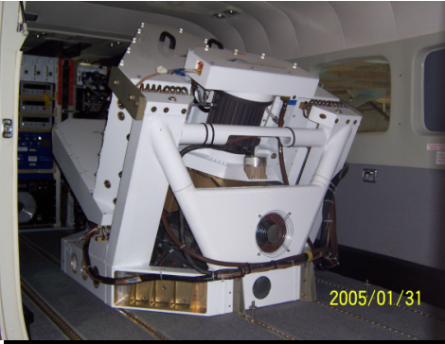
Physics and Engineers
Physics is the understanding that makes engineering design more efficient and, in some instances, possible.
Example: Tacoma Narrows Bridge
Personal Example: ITT ANGEL system wavelength design
Often, in my experience, an understanding of physics makes the difference that allows promotion within a discipline or advancement to system level engineering

Slide 21
Class Policies
We will follow the BYU-Idaho Honor Code in this class. In addition I would like to stress the following:
I expect professional behavior. Where I see unprofessional behavior, I will point it out so you get a good idea of what will be expected in your future jobs.
Plagiarism is a violation of the Honor code and will be grounds for a failing grade in this course. It may also cause other disciplinary action. If you use the work of another person (including a solution manual), you must give credit for that work. This is a rule that transcends college. It will be important in your future careers to establish intellectual property rights and to avoid law suits.
Cheating in any form, including claiming you made observations that you really didn't, is a gross violation of the honor code and most corporate values systems. Learning such behavior in school can lead to practices that would cause job termination, or even loss of life later in your career, so we will adhere to strict standards now.
Please do not discuss examinations administered in the testing center until the testing period has closed.
Please come to class on time
Complete the reading assignments before the lecture
Late assignments are highly discouraged. Late assignments are penalized 50% of their value for each class period past the due date
Learning the subject is the responsibility of each student. I will try in every way I can to facilitate the learning process. Please see me during my office hours or arrange a time with me to get extra help. I will assign you to work in groups and strongly recommend that you work together. (But be sure that the work you turn in is your own).
I will not post grades on Blackboard. Instead, I will periodically email your scores to your BYU-I account. You should check your grades to make sure I have recorded everything correctly.
Read the Syllabus

Slide 22
Procedures
Time in Class and Content: We will spend 60 minutes each day in class. Three days a week (MWF) will be lecture days. The other two are called “recitation days.” We will use at least one of these to do homework problems as groups. The homework load is quite substantial for this course because we will do many of the problems together. It is not a winning strategy to skip the homework days and try to do all the problems on your own. The course is not designed for this approach. I will also schedule special homework on Tuesdays and Thursdays that will require you to perform some measurements. On Tuesdays and Thursdays we will also reserve time for your presentations (see below).
We will not normally cover all the material in the chapter (derivations, example problems, etc.) You should come prepared to discuss this material. By “prepared” I mean that you should read the chapter sections assigned in the book before class starts. This is hard and takes some getting used to.

Slide 23
Procedures
Class attendance: It is very important that you attend class if you expect to keep up with assignments, examination preparation, etc. You will not see me taking roll, but I will always know from the clicker system if you are not attending class. I tend to “give the benefit of the doubt” (in terms of exam grading and final grades) to those students who faithfully attend class. If you must miss class for an interview or other BYU-I approved activity, please let me know in advance. You will be responsible for all information given as announcements in class whether you are there or not, so if you must miss, talk to me or to a trusted colleague to find out what happened in class.

Slide 24
Grading (1 of 2)
The class grade will consist of the following elements: daily quizzes, 13 homework assignments, 3 exams, a final exam, and a class presentation. The final grade will be based on the following weighting.
Tutorials | 10%
Quizzes | 5%
Exam Preparation Homework | 20%
Presentation | 5%
Pretest | 2%
Exam 1 | 10%
Exam 2 | 10%
Exam 3 | 10%
Exam 4 | 10%
Exam 5 | 10%
Final | 10%
Notes:
Final will be comprehensive
The third test is to not make the final so long

Slide 25
Grading (2 of 2)
There is no pre-assigned quota of A’s and C’s that will be given in the class. My personal goal is to give each of you all you need to earn an A. But it would not be beneficial to you if I artificially gave high grades. Level of effort and understanding of course material are two important factors to me in assigning letter grades.
93-100 | A |  | 73-77 | C
90-94 | A- |  | 70-73 | C-
87-90 | B+ |  | 67-70 | D+
83-87 | B |  | 63-67 | D
80-83 | B- |  | 60-63 | D-
77-80 | C+ |  | 0-60 | F
Letter grades will be assigned to the percentages of the final total score as shown in the table

Slide 26
Homework
Between 3 and 16 problems (sometimes more, sometimes less) will be assigned from each chapter.
We will also complete the Workbook sections that go with the text sections we have read.
Homework will be due on Wednesdays. I will try to not assign a problem until we have had a chance to talk about the material in class. Because of the holiday schedule, this sometimes makes the problem load uneven from assignment to assignment. You will know in advance what problems are assigned, and should plan time for the larger assignments.
You will not be able to finish the homework assignments in the hour and forty minutes a week of non-lecture time we have on Tuesdays and Thursdays. To make best use of this time, I suggest you look at the problems before the class homework sessions, and come prepared with questions. If you will miss a Tuesday or Thursday class, please let me know in advance.
You will turn in all of the homework problems. Neatness, organization, and use of the homework problem solving process will be part of the grade.
The homework problems will be posted on I-Learn

Slide 27
Solution Manuals
I am aware that there are solution manuals available through the physics tutors, the library, the internet (usually illegally) and from book sellers.
I have copies of these solution manuals as well.
To copy a solution from the manual without noting that you have done so is to commit plagiarism. Since this is a violation of the Honor Code, please do not do this.
Also note that the homework process requires much more than is provided in the solutions given by the authors. If you limit your solution to what is in the manual, the best you could hope for is half credit.
Consistently using the manual’s solutions will not prepare you for the exams, and will likely lead to a very poor understanding of the material and an unfortunate grade.
If you are stuck on a problem, then consulting a manual might be a reasonable use of a solution manual, but be sure to form your own solution. Consulting a physics tutor or talking to me might be even better.

Slide 28
Quizzes
There will be a quiz held every lecture period.
The quizzes are intended to encourage you to read and prepare for class. In past semesters, there has been some dismay on the part of those who neglect this preparation when they see the affect of quizzes on their final grade. The quizzes are small but they add up. Preparation is important!
There are no make-ups for the quizzes.

Slide 29
Class Presentation
Each student will give one class presentation during the semester.
We will pick one section from the textbook and give a 10 minute presentation on a topic related to that section.
The objective of the presentation is not to cover the contents of the textbook section.
The objective of the presentation is to show how the physics principle is utilized in real world applications.
Students will be graded on the basis of creativity, extent of their research, and their presentation medium.
Please do not use any material that would violate the honor code
A sign up sheet will be available you should choose a topic now and determine when you would like to present.

Slide 30
Examinations
The exam questions will stress problem solving.
A typical exam will consist of ten problems Half of which will be conceptual
As with the homework, the method used is as important as a correct answer.
Partial credit will be given based on the correctness of the method used.
The same problem solving process used for homework should be used on the exam questions.
Notes:
I reserve the right to adjust the value of the test to make up for extra hard tests
No extra penalty
I will not adjust the value of the test to make up for extra easy tests
Again, no extra penalty
Student has missed out on a fair assessment of their performance

Slide 31
Teaching Method
Active class
Emphasis on concepts on lecture days
Emphasis on problem solving on homework days
Notes:
If you have trouble with this style of lecture, please let me know
This is in keeping with direction from President Clark

Slide 32
Oscillation

Slide 33
m
x = 0
x_{max}

Slide 34
Question 123.1.2
You leave class one day, and return the next day. Is this an example of simple harmonic motion?
No, this is periodic motion, but not simple harmonic motion
No, this is not periodic motion, so it cannot be simple harmonic motion
Yes, this is simple harmonic motion because you returned to the same place.
Yes, this is simple harmonic motion because it is periodic.

Slide 35
Question 123.1.3
Is the graph of position vs. time shown an example of simple harmonic motion?
Yes it is
No it is not
Be prepared to defend your case
x
t

Slide 36
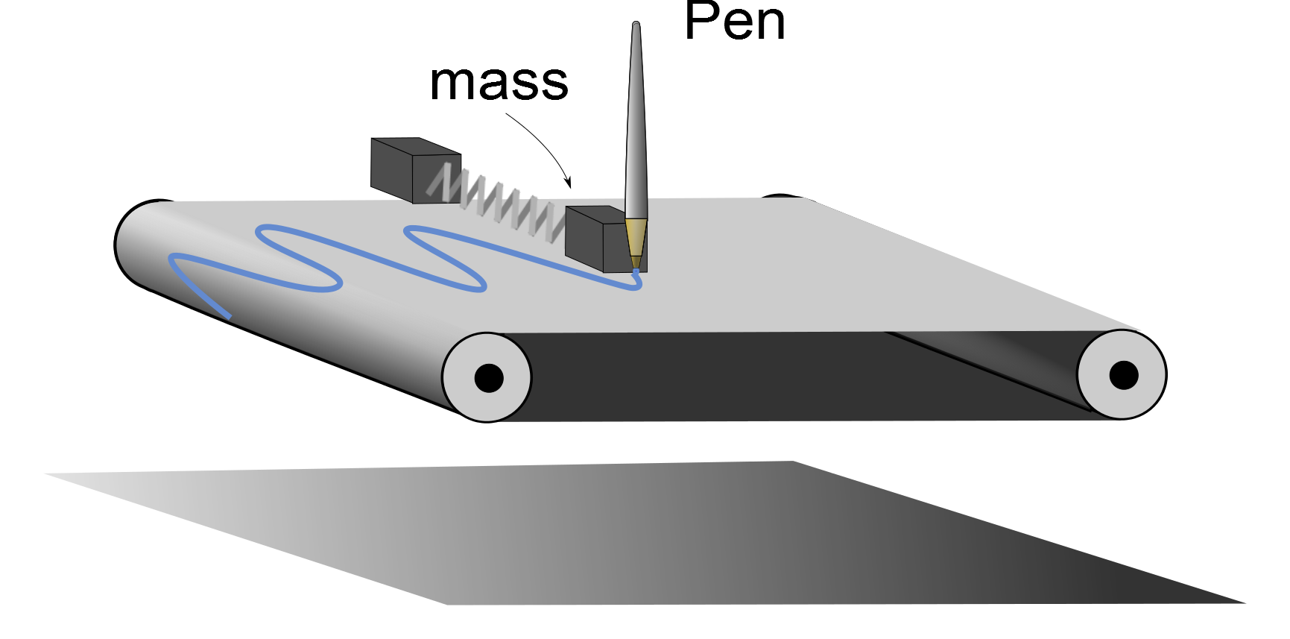

Slide 39
Question 123.1.5
Simple Harmonic motion is characterized by a velocity that..
Is constant
Decreasing
Increasing
Constantly changes

Slide 40
Question 6.8
For the graph of simple harmonic motion to the right, what do we call the part of the graph indicated by the blue arrows.
a) Amplitude
b) Frequency
c) Period
d) Phase

Slide 42
Question 6.8.5
I have an oscillator with a frequency of 440Hz. Which answer below is closest to the period?
a) 400s
b) 0.0025s
c) 220s
d) 800s

Slide 43
Question 6.9
For the graph of simple harmonic motion to the right, what do we call the part of the graph indicated by the green arrows.
a) Amplitude
b) Frequency
c) Period
d) Phase

Slide 46
Question 6.10
Compare the graphs of simple harmonic motion to the right the blue curve has a different _______ than the other one
a) Amplitude
b) Frequency
c) Period
d) Phase

Slide 48
Question 6.11
I have a mass on a spring undergoing simple harmonic motion. The amplitude is 5m. The frequency is 2Hz. The phase is 0 degrees. When the time is t=2sec, what is the distance the mass will be from the equilibrium point.
5m
-5m
2.5m
0m

Slide 49
Question 6.8
For the graph of simple harmonic motion to the right, what do we call the part of the graph indicated by the blue arrows.
a) Amplitude
b) Frequency
c) Period
d) Phase

Slide 50
Question 123.1.4
The period of a pendulum swing is how long it takes the pendulum bob to go…
All the way from one side to the other side
Half way from one side to the other side
Three quarters’ of the way from one side to the other side
All the way from one side to the other side and back to the starting point.

Slide 51
Question 6.8.5
I have an oscillator with a frequency of 440Hz. Which answer below is closest to the period?
a) 400s
b) 0.0025s
c) 220s
d) 800s

Slide 53
Question 6.9
For the graph of simple harmonic motion to the right, what do we call the part of the graph indicated by the green arrows.
a) Amplitude
b) Frequency
c) Period
d) Phase

Slide 54
Question 123.1.6
A block on a spring is pulled to position x=x_{max} (called A in the book) and released. In one full cycle of motion, through what total distance does it travel
A/2
A
2A
4A

Slide 55
Question 123.1.7
A mass on a spring in SHM has amplitude A and period T. What is the net displacement of the mass after a time interval T?
0
A/2
A
2A
4A

Slide 56
Question 6.7
Which of the following quantities form sinusoidal patters in a quantity vs. time graph?
Position
Velocity
Acceleration
All of the above

Slide 60
Comparison: SHM Position and Velocity
90° out of phase
x
When x =x_{max}, v=0
When v=v_{max}, x=0
v
T/2
T

Slide 61
a=0
V_{max}
m
x=0
x_{max}
a_{max}
a_{max}
k
V=0
V=0
m
m
-x_{max}
x=0
x_{max}
x=0
a=0
V_{max}
m
x=0
x_{max}

Slide 62
a_{max}
N_{mT}
k
V=0
S_{ms}
m
x=0
x_{max}
W_{mE}

Slide 63
a=0
V_{max}
m
x=0
x_{max}

Slide 64
a_{max}
k
V=0
m
y = 0
x=0
x_{max}

Slide 65
a_{max}
V=0
m
y = 0
-x_{max}
x=0

Slide 66
Question 123.1.9
What does it mean for two oscillators to be “in phase?”
That they have the same position relative to the Sun.
That they rise and fall together
That they both have emotional problems
I saw this on Star Trek, it means they are in the same place, but you can’t see them

Slide 67
Question 6.10
Compare the graphs of simple harmonic motion to the right the blue curve has a different _______ than the other one
a) Amplitude
b) Frequency
c) Period
d) Phase

Slide 68
Question 6.11
I have a mass on a spring undergoing simple harmonic motion. The amplitude is 5m. The frequency is 2Hz. The phase is 0 degrees. When the time is t=2sec, what is the distance the mass will be from the equilibrium point.
5m
-5m
2.5m
0m

Slide 69
Equilibrium Position
F_{s}
m
x=0
x_{max}
m
x=0
x_{max}
F_{s}
m
-x_{max}
x=0

Slide 70
m
x = 0
x_{max}

Slide 71
v_{i}
m
x = 0
x_{max}

Slide 72
A particle moving along the x-axis in simple harmonic motion starts from its equilibrium position, the origin, at t=0 and moves to the right. The amplitude of its motion is 2.00cm , and the frequency is 1.50Hz .
a) show that the position of the particle is given by
x=(2.00cm )sin(3.00πt)
determine
b) the maximum speed and the earliest time (t>0) at which the particle has this speed,
c) the maximum acceleration and the earliest time (t>0) at which the particle has this acceleration, and
d) the total distance traveled between t=0 and t=1.00s

Slide 73
Question 123.1.11
QQ 15.6 A circular object is in uniform motion. The drawing is at t=0. The projection on the x-axis shown will have what amplitude and phase?
0.50 m and 0
1.00m and 0
0.50m and π
1.00m and π
Can you draw a graph of x vs. t?
0.50m
x

Slide 74
Question 123.1.12
The circular object pictured here is made to rotate clockwise at 29 revolutions per second. It is filmed with a camera that takes 30 frames per second. Compared to its actual motion, the dot on the film appears to move
Clockwise at a very slow rate
Counterclockwise at a very slow rate
Clockwise at a very fast rate
Counterclockwise at a very fast rate
In a random fashion

Slide 75
Trigonometry
ĵ
Remember defining trig functions on a unit circle?
P
y
h
θ
x
î

Slide 76
Trigonometry
ĵ
Suppose we define points along the x-axis (and let the circle have radius h)
P
y
h
θ
-x_{max}
x
x_{max}
î

Slide 77
Dot product
ĵ
We could express the length x as the component of the radius vector or
P
y
r
θ
-x_{max}
x
x_{max}
î

Slide 78
Relationship to SHM
ĵ
The projection of the position of point P on the x axis displays SHM!
P
h
θ
-x_{max}
x
x_{max}
î
SHM along a straight line can be thought of as a projection of a uniform circular motion along a diameter of a reference circle

Slide 79
More Geometry
We can also define points along the y-axis
ĵ
y_{max}
P
y
h
θ
-x_{max}
x
x_{max}
î
-y_{max}

Slide 80
Relationship to SHM
ĵ
This is just two SHOs
One in the x direction
One is the y direction
y_{max}
P
y
h
θ
-x_{max}
x
x_{max}
î
-y_{max}

Slide 81
Equations for the two SHOs
The equation in X is familiar
The projection onto the y-axis is a sine function
An old trig identity says:
What does this say about the phases of the two SHOs?

Slide 82
Rotation and Velocity
Look at the Angular Speed
Then
Let’s take the x-component
ĵ
v_{t}
v_{tx}
θ
y
θ
v_{tx}
î

Slide 83
Rotation and Acceleration
The acceleration of the particle at P is given by
Taking the x- component
ĵ
a_{x}
θ
y
a
θ
a_{x}
î

Slide 84
End of Lecture 1

Slide 85
Question 123.1.10
A mass-spring system is experiencing SHM. At a time, t, it has its maximum value of kinetic energy. At t, its potential energy due to the spring is
Positive
Zero
Negative
Positive but decreasing
Negative but increasing
m
x=0
x_{max}

Slide 86
Pen

Slide 87
Pen

Slide 88
Pen

